Slide 1
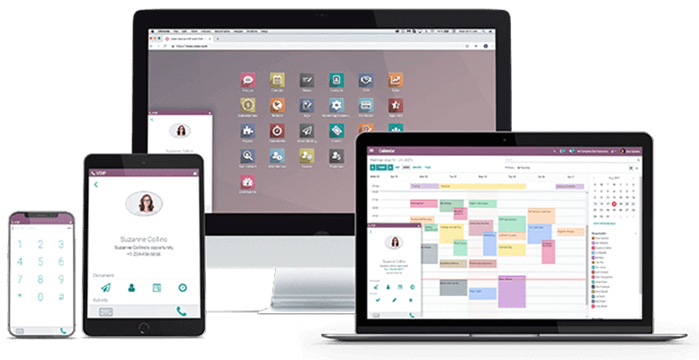
TRIA’S Odoo ERP
BY TRIA TRADING
April/27/2023

Slide 2
About US
Tria is a Software Development company founded and managed by enthusiastic team of professionals.
All three founders having attained MScs in Computer Science and Computer Engineering, our skillset and education has allowed us to work for some great companies and garner a great deal of experience.
Tria focuses on digitalization of business processes to help the public and private sector optimize their productivity, increase their efficiency and enhance their customer experience while saving cost and man hours
We have better understanding expreince on on ERP Bussiness process
We also Have better expreince on on mobile and web applications
© Copyright 2023. Tria Trading PLC. All rights reserved.

Slide 3
Partners
Our Partners
Dell
Motorolla
Microsoft
Huawei
Samsung
Cisco
Lenovo
Newgen
Check Point

Slide 4
What is ERP ?
What is ERP ?
An enterprise resource planning (ERP) system is a software application with a centralized database that can be used to run an entire company

Slide 5
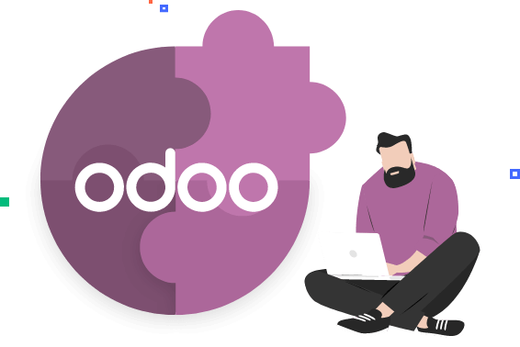
About
Odoo

Slide 6
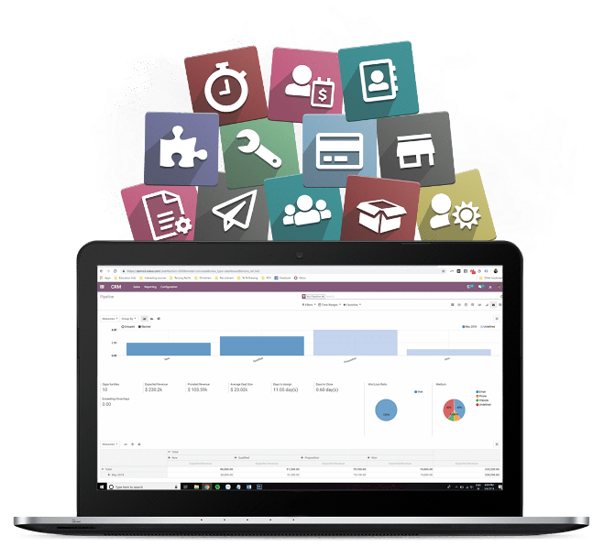
TRIA’S
ODOO ERP
WHAT IS ODOO
Odoo Also known as Open ERP was founded by Fabien Pinckaers in 2005. The word Odoo is the acronym of
On-Demand Open Object.
Odoo is a large collection of business-related applications and modules like CRM, Sales, E-commerce, Warehouse, Purchase, Accounting suit, Manufacturing, HRMS, etc.
All these basic modules collectively called Enterprise Resource Planning software.
here are some well-known International companies that have publicly acknowledged their use of Odoo:
Danone:
Hyundai Heavy Industries:
Interpolis:
Toyota Tsusho Africa
Maersk Oil:
Interpolis:
Veolia:
Luxair:
Fruity Chutes:
BioSpectrum:
Notes:
Danone: A multinational food-products corporation known for its dairy products, bottled water, baby food, and medical nutrition products.
Hyundai Heavy Industries: A global industrial conglomerate involved in various sectors, including shipbuilding, offshore engineering, construction equipment, and more.
Interpolis: A leading insurance company based in the Netherlands, offering a range of insurance products and services.
Decathlon: A multinational sporting goods retailer and manufacturer, offering a wide range of sports equipment, apparel, and accessories.
Toyota Tsusho Africa: A part of the Toyota Group and one of the largest trading companies in Africa, engaged in various industries such as automotive, energy, metals, and more.
Maersk Oil: An international oil and gas company and a subsidiary of the Maersk Group, involved in exploration, production, and transportation of oil and gas resources.
Luxair: The national airline of Luxembourg, providing scheduled and charter flights to various destinations in Europe and beyond.
Veolia: A global leader in optimized resource management, offering water, waste, and energy management solutions to businesses and municipalities.
Fruity Chutes: A manufacturer of drone parachutes and recovery systems, serving the drone industry worldwide.
BioSpectrum: A biotechnology company specializing in the production of research-grade and GMP-grade recombinant proteins.

Slide 7
System Security

Slide 8
Security Measure
Strong Password Policies
User Access Control
Two-Factor Authentication (2FA)
Secure Network Configuration
Regular Updates and Patches
Secure Hosting Environment
Data Backup and Recovery
Secure Extensions and Customizations
Secure By design
The Framework is ranked first in OWASP security
Notes:
Strong Password Policies: Enforce the use of strong passwords for user accounts in Odoo. This includes requiring a combination of upper and lowercase letters, numbers, and special characters. Encourage users to regularly update their passwords.
User Access Control: Implement role-based access control (RBAC) to restrict user access to specific modules and functionalities within Odoo based on their roles and responsibilities. Assign permissions carefully to ensure that users only have access to the necessary data and functions.
Two-Factor Authentication (2FA): Enable 2FA for Odoo to add an extra layer of security during the login process. This typically involves requiring users to provide a second form of authentication, such as a verification code sent to their mobile device, in addition to their password.
Secure Network Configuration: Ensure that Odoo is deployed on a secure network infrastructure. This may include using firewalls, intrusion detection systems, and virtual private networks (VPNs) to protect the system from unauthorized access and network-based attacks.
Regular Updates and Patches: Keep Odoo up to date with the latest security patches and updates. Odoo periodically releases security updates to address vulnerabilities and enhance system security. Stay informed about these updates and apply them promptly.
Secure Hosting Environment: If you are hosting Odoo on your own servers, make sure that the hosting environment is secure. Implement best practices for server security, including regular security audits, secure configurations, and monitoring for potential security breaches.
Data Backup and Recovery: Regularly back up your Odoo database and related files to ensure data integrity and availability. Store backups in a secure location, preferably off-site or in the cloud. Test the backup and recovery process periodically to ensure its effectiveness.
Secure Extensions and Customizations: Be cautious when installing third-party extensions or customizing Odoo. Only use trusted and verified extensions from reputable sources. Review the code of customizations thoroughly to identify and mitigate potential security risks.
Secure By Design
✓SQL injections are prevented by the use of a higher-level API that does not require manual SQL queries.
✓XSS attacks are prevented by the use of a high-level templating system that automatically escapes injected data.
✓The framework prevents RPC access to private methods, making it harder to introduce exploitable vulnerabilities.
OWSAP (Open Web Application Security Project)

Slide 9
System Architecture

Slide 10
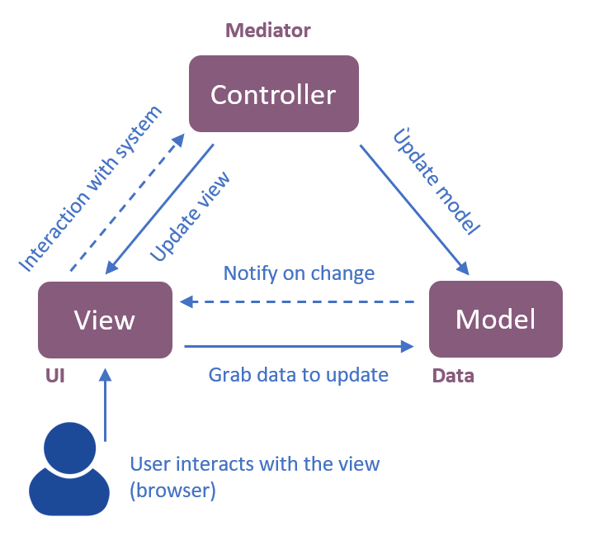
TRIA’S
ODOO ERP
Front End Architecture
Front End Architecture
The frontend architecture of Odoo is based on web technologies.
It utilizes a Model-View-Controller (MVC) pattern to separate the presentation logic (view) from the data (model) and the interaction logic (controller).
Notes:
web technologies such as HTML, CSS, and JavaScript.

Slide 11
TRIA’S
ODOO ERP
Front End Architecture
The frontend architecture consists of the following components:
Templates: QWeb and Jinja2 for defining structure and layout
Views: Arrange fields and UI elements
JavaScript: Handle client-side interactions and provide dynamic functionality
CSS: Define visual styles and layouts
Widgets: Pre-built UI components (forms, lists, graphs)
Notes:
QWeb & Jinja2 provide a way to dynamically generate HTML content by combining static elements with dynamic data. Jinja2 is a general-purpose templating engine written in Python and is widely used in various web framework
Jinja2 is widely adopted in the Python ecosystem due to its flexibility, ease of use, and close integration with Python frameworks.

Slide 12
TRIA’S
ODOO ERP
Backend Architecture
Backend Architecture
The backend architecture of Odoo is based on a layered structure and follows an object-oriented programming (OOP) approach.
The backend architecture consists of the following components:
Models: Define data structure and behavior
Controllers: Handle requests, route to models and methods
ORM: Object Relational Mapping for database interactions
Business Logic: Workflows, rules, calculations, validations
Security: Authentication, authorization, access control
APIs: Extend and integrate with external applications

Slide 13
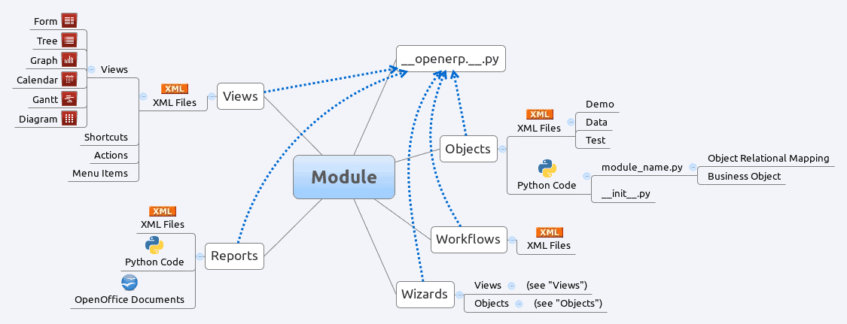
TRIA’S
ODOO ERP
Odoo Modular Structure
Odoo architecture supports a standard approach each from a development perspective and a preparation purpose of reading. In essence, a module teams everything associated with one concern in one purposeful entity. it’s comprised of models, views, workflows, and wizards.

Slide 14
System Scalability

Slide 15
TRIA’S
ODOO ERP
Ability/Scalability for Customization
Flexibility to Customize:
Odoo offers a modular architecture
Choose and customize specific modules as required
Configure the system to match unique workflows and processes
In-House Capacity:
Ability to modify and tailor the system internally
Utilize in-house resources, such as developers and IT team
Customize UI, workflows, reports, and business logic
Extensibility:
Odoo provides APIs and development tools
Extend system functionality with custom modules or integrations
Develop new features or integrate with existing systems

Slide 16
TRIA’S
ODOO ERP
Scalability with Bureau, organizations and User Growth
System Scalability:
Odoo is designed to accommodate growth
Scales with the increasing demands of new organizations, agencies or Bureau and users
Handles larger data volumes, transactions, and user loads
Performance Optimization:
Architecture supports high-performance requirements
Efficient database queries and caching mechanisms
Load balancing and server optimization techniques
Vertical and Horizontal Scaling:
Vertical scaling: Upgrade hardware resources (CPU, RAM, etc.)
Horizontal scaling: Distribute workload across multiple servers

Slide 17
Integration Approach

Slide 18
TRIA’S
ODOO ERP
Integration Approach with Other Systems
API Availability:
Odoo provides comprehensive APIs for integration
RESTful API, XML-RPC, and other protocols supported
Enables seamless integration with external systems and services
Data Synchronization:
Exchange data between Odoo and other systems
Real-time or scheduled synchronization of information
Bi-directional data flow for consistency
Third-Party Integrations:
Odoo supports integration with popular third-party applications
CRM, e-commerce, payment gateways, shipping services, etc.
Extend functionality and streamline operations

Slide 19
Feature of the system

Slide 20
TRIA’S
ODOO ERP
Features of the System
Comprehensive Suite of Applications:
Odoo offers a wide range of integrated business applications
All-in-one solution for streamlined operations
Modular and Customizable:
Select and customize modules as per specific requirements
Tailor the system to match unique workflows and processes
User-Friendly Interface:
Intuitive and user-friendly interface design
Easy navigation, consistent layout, and responsive UI
Best Practice Implementation:
Odoo follows industry best practices in system design and functionality
Incorporates standard business processes and workflows

Slide 21
TRIA’S
ODOO ERP
Features of the System
Real-Time Reporting:
Odoo reporting is capable of generating reports in real-time, providing users with up-to-date information to make informed decisions.
Multi-Language Support:
it supports multiple languages, including ethiopian local languages (Amharic, Tigrigna, Oromifa, Somali, Afar etc). the multi language support is for the entire sub-system user can use the system with his prefered language.
Multi-Organization management:
our system allows users to manage multiple companies, organizations, public and private sectors, Bureau’s and Agencies from a single application. Users can create separate databases, manage different chart of accounts, and configure different settings for each company.

Slide 22
TRIA’S
ODOO ERP
Features of the System
Centralized data management:
we provides a centralized database for all the bireau’s, offices and agencies. This enables users to access and manage data across multiple organization with ease.
Customizable reports:
Odoo allows users to create customized reports for each organization, which enables users to get a clear picture of each bureau and office financial performance.
Third-Party Integrations:
the system supports seamless integration with a variety of third-party systems, such as payment gateways, shipping providers, marketing tools, and more.
Community Support and Updates:
Regular updates, bug fixes, and security patches
Access to community-driven modules and enhancements
Notes:
Third-Party Integrations:
This allows businesses to leverage their existing infrastructure and integrate Odoo into their existing technology stack.

Slide 23
TRIA ERP Base System Solution

Slide 24
TRIA ERP Accounting System Solution

Slide 25
TRIA ERP CRM System Solution

Slide 26
TRIA ERP Ecommerce System Solution

Slide 27
TRIA ERP HR System Solution

Slide 28
TRIA ERP Manufacturing System Solution

Slide 29
TRIA ERP Point to Sale System Solution

Slide 30
TRIA ERP Project Management System Solution

Slide 31
TRIA ERP Purchase Management System Solution

Slide 32
TRIA ERP Sales System Solution

Slide 33
TRIA ERP Warehouse System Solution

Slide 34
TRIA ERP Website Builder System Solution

Slide 35
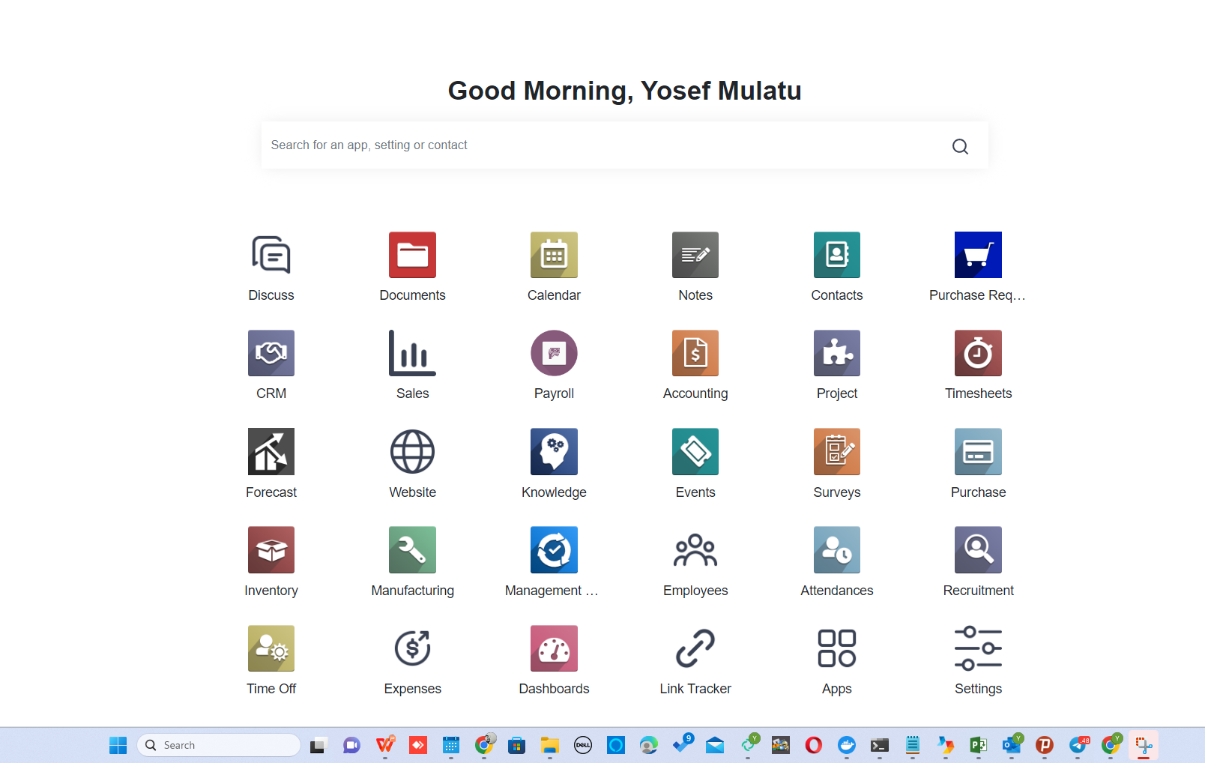
TRIA-ERP
Web: triaplc.com
Mail: info@triaplc.com
Address: Lingo Tower, 11th Floor, Bole Medhanialem, Addis Ababa,Po.Box 1110, Ethiopia

